Slide 1

Deep Learning Crash Course
Hui Xue
Fall 2021
www.deeplearningcrashcourse.org

Slide 2
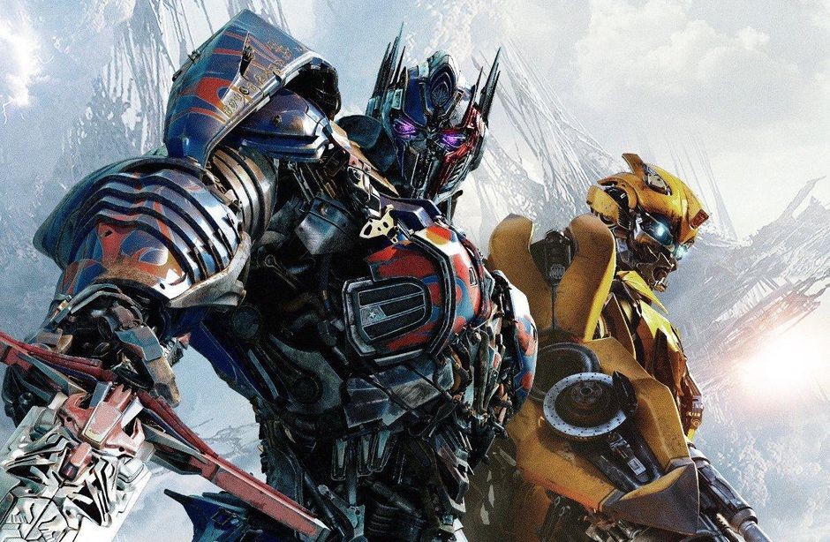
Outline
Attention mechanism in detail
Seq2Seq Transformer
Review on Elmo, Bert, GPT models
Trending towards bigger model
Attention for images
https://www.cnet.com/news/transformers-animated-movie-in-production-despite-coronavirus-quarantine/

Slide 3
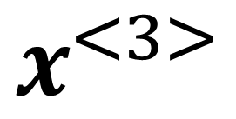
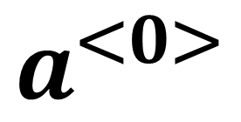
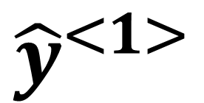
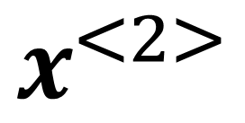
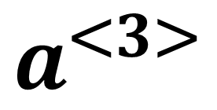
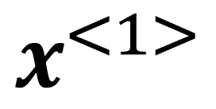
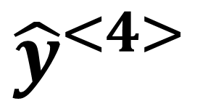
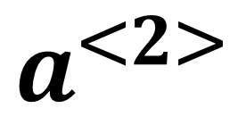
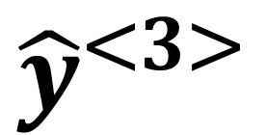
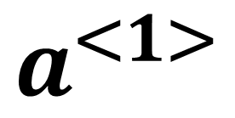
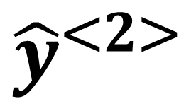
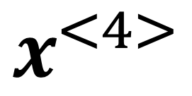
Modeling sequence with variable length
$${\hat{y}}^{<1>}$$
$${\hat{y}}^{<2>}$$
$${\hat{y}}^{<3>}$$
$${\hat{y}}^{<4>}$$
RNN or bidirectional RNN
Sequential processing
Use internal state to carry information through time
$$a^{<1>}$$
$$a^{<2>}$$
$$a^{<3>}$$
$$a^{<0>}$$
$$x^{<1>}$$
$$x^{<2>}$$
$$x^{<3>}$$
$$x^{<4>}$$

Slide 4
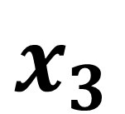
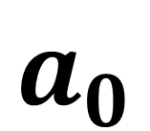
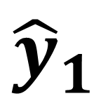
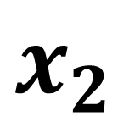
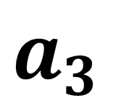
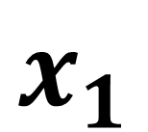
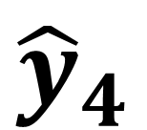
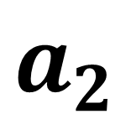
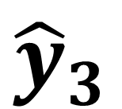
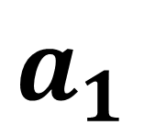
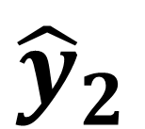
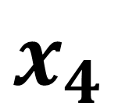
Modeling sequence with variable length
Change the notation for time steps
$${\hat{y}}_{1}$$
$${\hat{y}}_{2}$$
$${\hat{y}}_{3}$$
$${\hat{y}}_{4}$$
RNN or bidirectional RNN
Sequential processing
Use internal state to carry information through time
$$a_{1}$$
$$a_{2}$$
$$a_{3}$$
$$a_{0}$$
$$x_{1}$$
$$x_{2}$$
$$x_{3}$$
$$x_{4}$$

Slide 5
Best of two worlds
$${\hat{y}}_{1}$$
$${\hat{y}}_{2}$$
$${\hat{y}}_{3}$$
$${\hat{y}}_{4}$$
FC
FC
FC
FC
Parallel processing
Handle sequence data with variable length
$$x_{1}$$
$$x_{2}$$
$$x_{3}$$
$$x_{4}$$

Slide 6
Best of two worlds: self-attention
$${\hat{y}}_{1}$$
$${\hat{y}}_{2}$$
$${\hat{y}}_{3}$$
$${\hat{y}}_{4}$$
Parallel processing
Handle sequence data with variable length
Every output takes contributions from all inputs
$$x_{1}$$
$$x_{2}$$
$$x_{3}$$
$$x_{4}$$

Slide 7
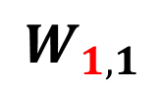
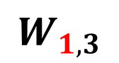

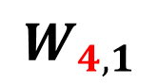
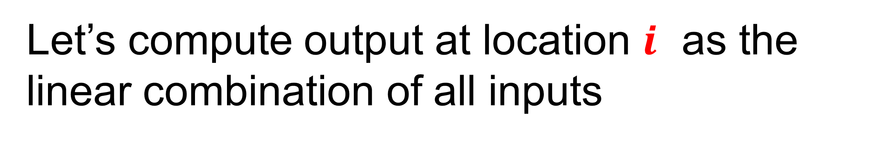
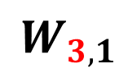
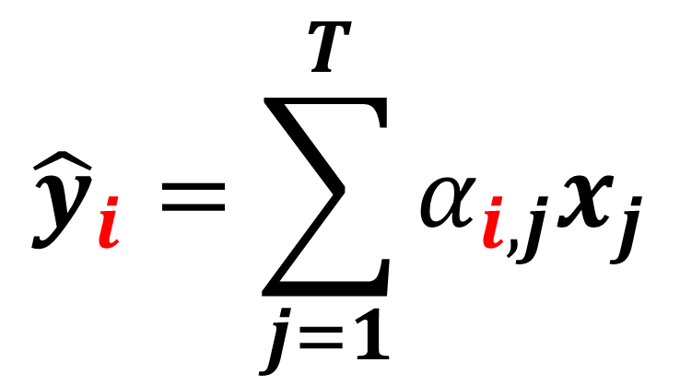
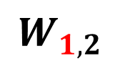
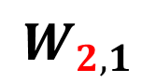
Self-attention
Let’s compute output at location $i$ as the linear combination of all inputs
$${\hat{y}}_{1}$$
$${\hat{y}}_{2}$$
$${\hat{y}}_{3}$$
$${\hat{y}}_{4}$$
$${\hat{y}}_{i}=\sum_{j=1}^{T}{α_{i,j}x_{j}}$$
$$W_{1,1}$$
$$W_{1,4}$$
$$W_{2,1}$$
$$W_{3,1}$$
$$W_{4,1}$$
$$W_{1,3}$$
Need an intuitive way is to compute weights $α_{i,j}$
$$W_{1,2}$$
$$x_{1}$$
$$x_{2}$$
$$x_{3}$$
$$x_{4}$$

Slide 8
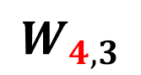
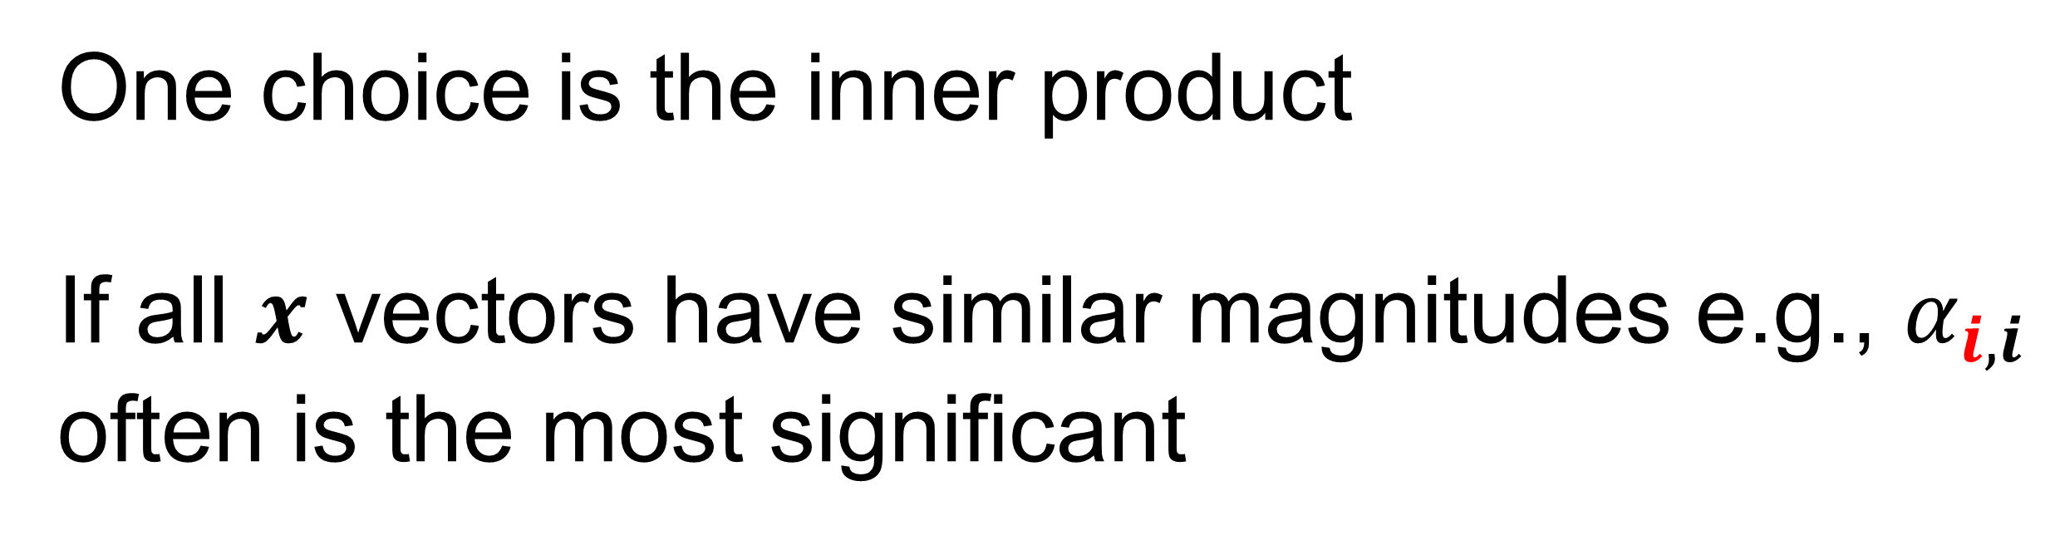

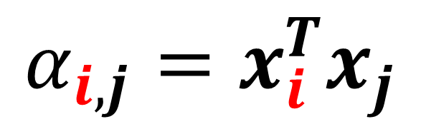
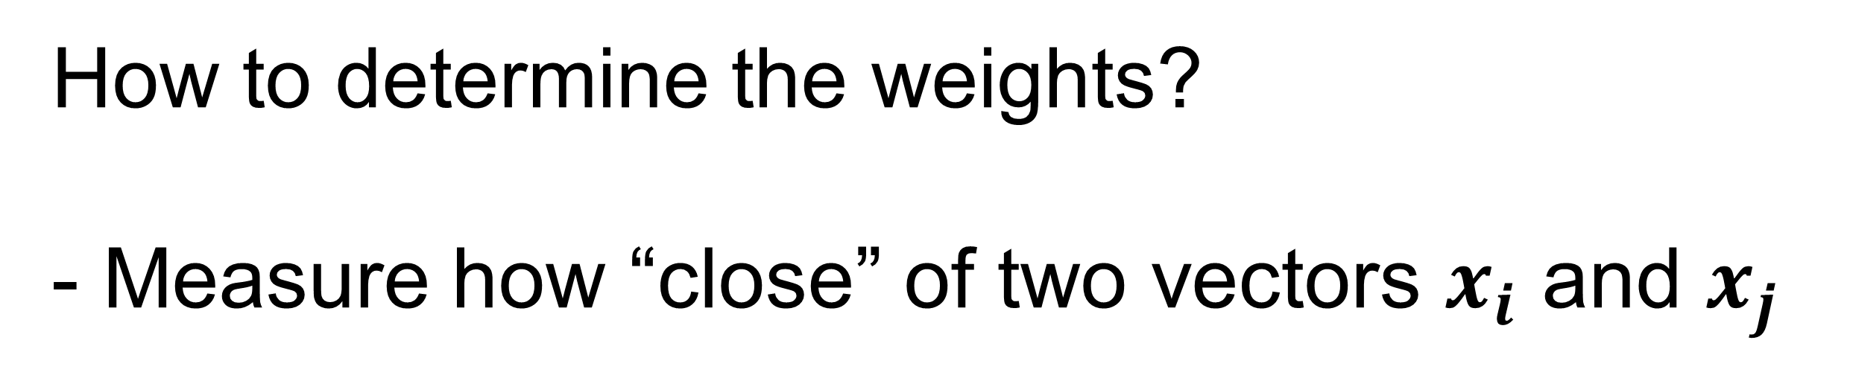
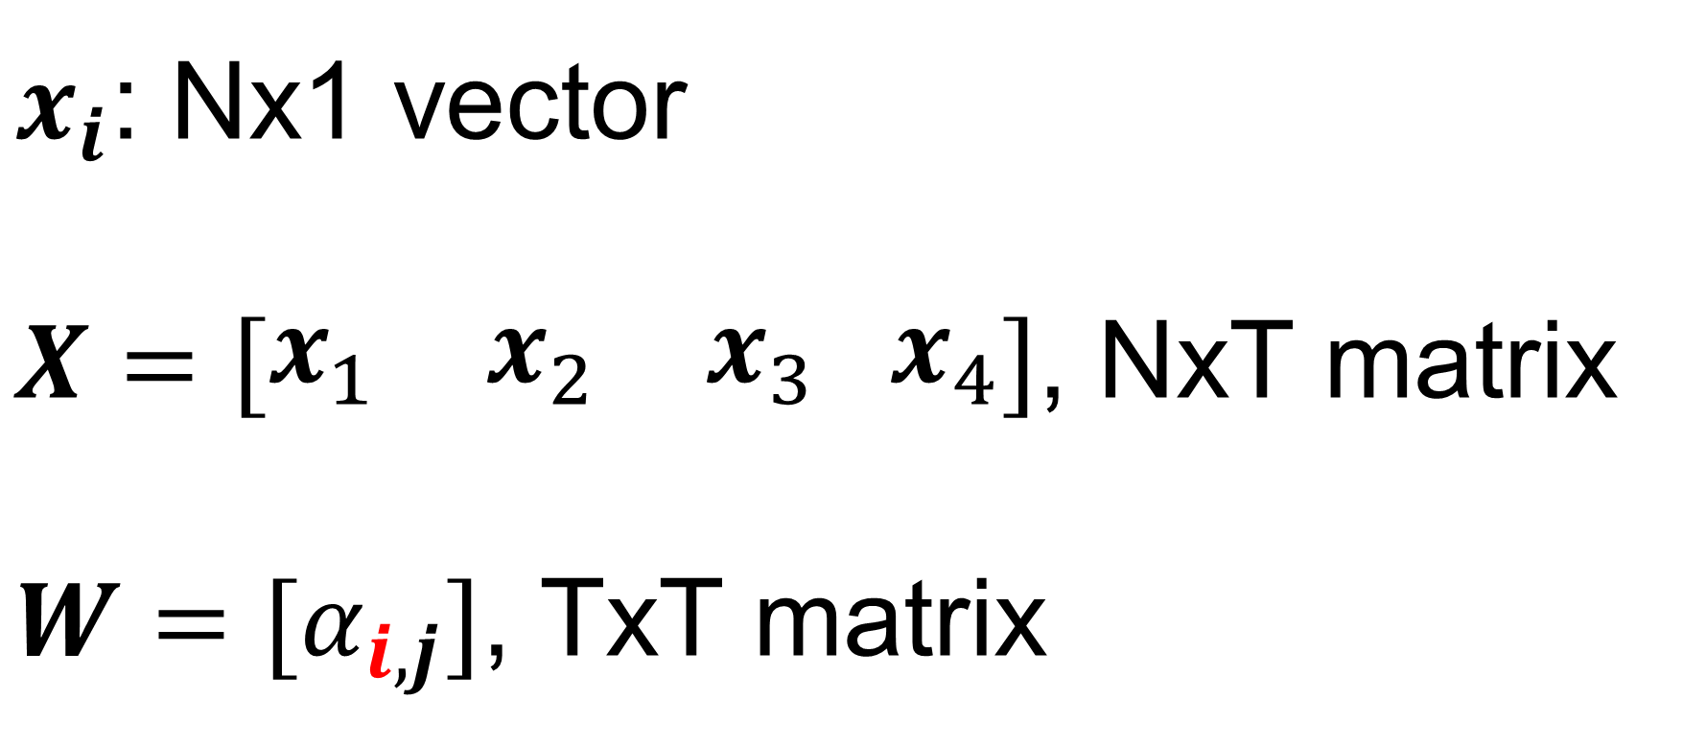
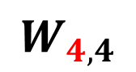
Self-attention
How to determine the weights?
- Measure how “close” of two vectors $x_{i}$ and $x_{j}$
$${\hat{y}}_{1}$$
$${\hat{y}}_{2}$$
$${\hat{y}}_{3}$$
$${\hat{y}}_{4}$$
$$α_{i,j}=x_{i}^{T}x_{j}$$
$$W_{1,4}$$
$$W_{4,1}$$
One choice is the inner product
If all $x$ vectors have similar magnitudes e.g., $α_{i,i}$ often is the most significant
$$W_{1,1}$$
$$W_{4,4}$$
$$W_{1,3}$$
$$W_{4,2}$$
$$W_{1,2}$$
$$W_{4,3}$$
$x_{i}$: Nx1 vector
$X=\left[\begin{matrix}x_{1} & x_{2} & x_{3} x_{4}\end{matrix}\right]$, NxT matrix
$W=[α_{i,j}]$, TxT matrix
$$x_{1}$$
$$x_{2}$$
$$x_{3}$$
$$x_{4}$$
T positions/locations/time steps

Slide 9
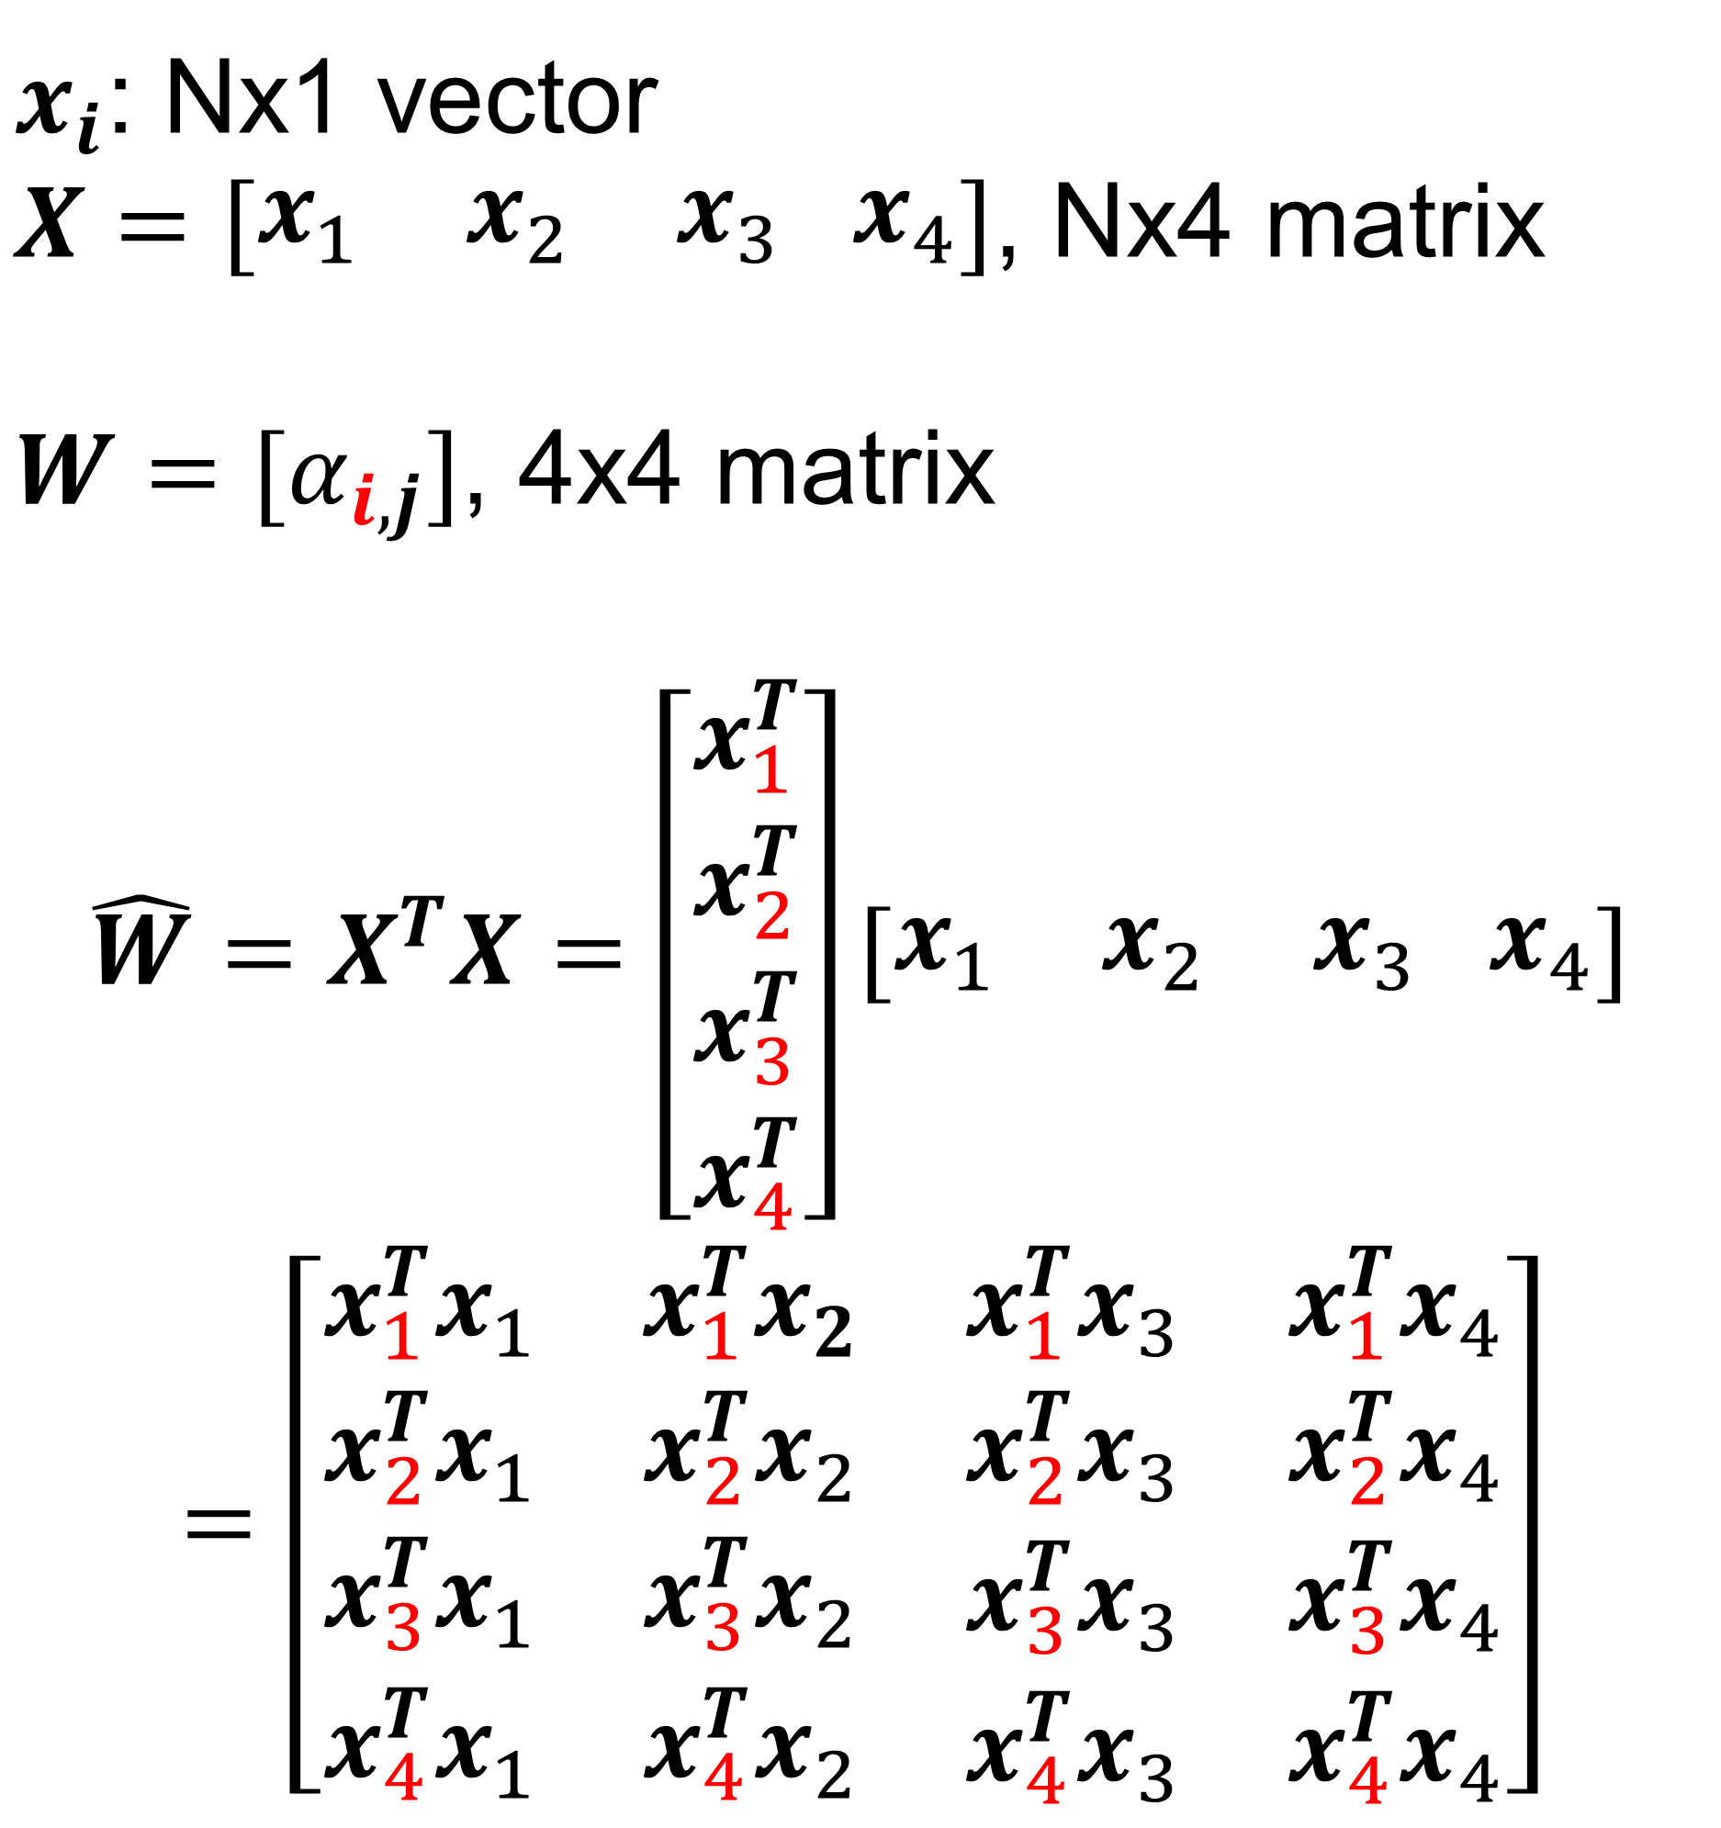
Self-attention
$x_{i}$: Nx1 vector
$X=\left[\begin{matrix}x_{1} & x_{2} & x_{3} x_{4}\end{matrix}\right]$, Nx4 matrix
$W=[α_{i,j}]$, 4x4 matrix
$$\hat{W}=X^{T}X=\left[\begin{matrix}x_{1}^{T} \\ \begin{aligned}x_{2}^{T} \\ x_{3}^{T} \\ x_{4}^{T}\end{aligned}\end{matrix}\right]\left[\begin{matrix}x_{1} & x_{2} & x_{3} x_{4}\end{matrix}\right]$$
$$=\left[\begin{matrix}\begin{aligned}x_{1}^{T}x_{1} \\ x_{2}^{T}x_{1}\end{aligned} & \begin{aligned}x_{1}^{T}x_{2} \\ x_{2}^{T}x_{2}\end{aligned} & \begin{aligned}\begin{matrix}x_{1}^{T}x_{3} & x_{1}^{T}x_{4}\end{matrix} \\ \begin{matrix}x_{2}^{T}x_{3} & x_{2}^{T}x_{4}\end{matrix}\end{aligned} \\ x_{3}^{T}x_{1} & x_{3}^{T}x_{2} & \begin{matrix}x_{3}^{T}x_{3} & x_{3}^{T}x_{4}\end{matrix} \\ x_{4}^{T}x_{1} & x_{4}^{T}x_{2} & \begin{matrix}x_{4}^{T}x_{3} & x_{4}^{T}x_{4}\end{matrix}\end{matrix}\right]$$
$${\hat{y}}_{1}$$
$${\hat{y}}_{2}$$
$${\hat{y}}_{3}$$
$${\hat{y}}_{4}$$
$$W_{1,1}$$
$$W_{1,4}$$
$$W_{4,1}$$
$$W_{4,4}$$
$$W_{1,3}$$
$$W_{4,2}$$
$$W_{1,2}$$
$$W_{4,3}$$
$$x_{1}$$
$$x_{2}$$
$$x_{3}$$
$$x_{4}$$
T=4

Slide 10
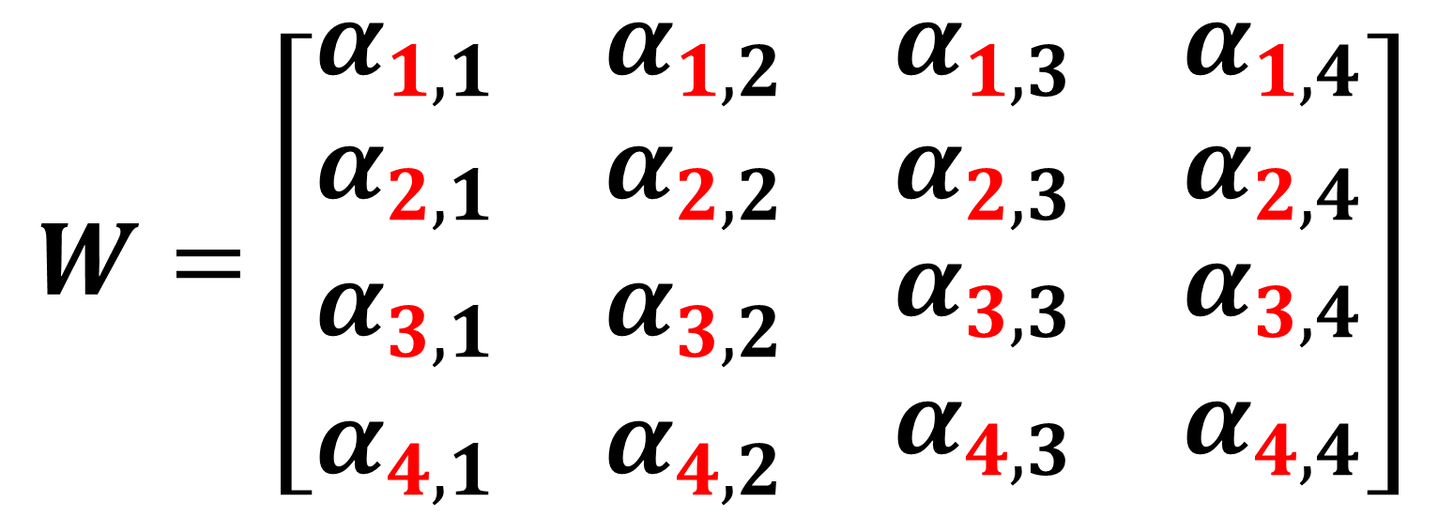
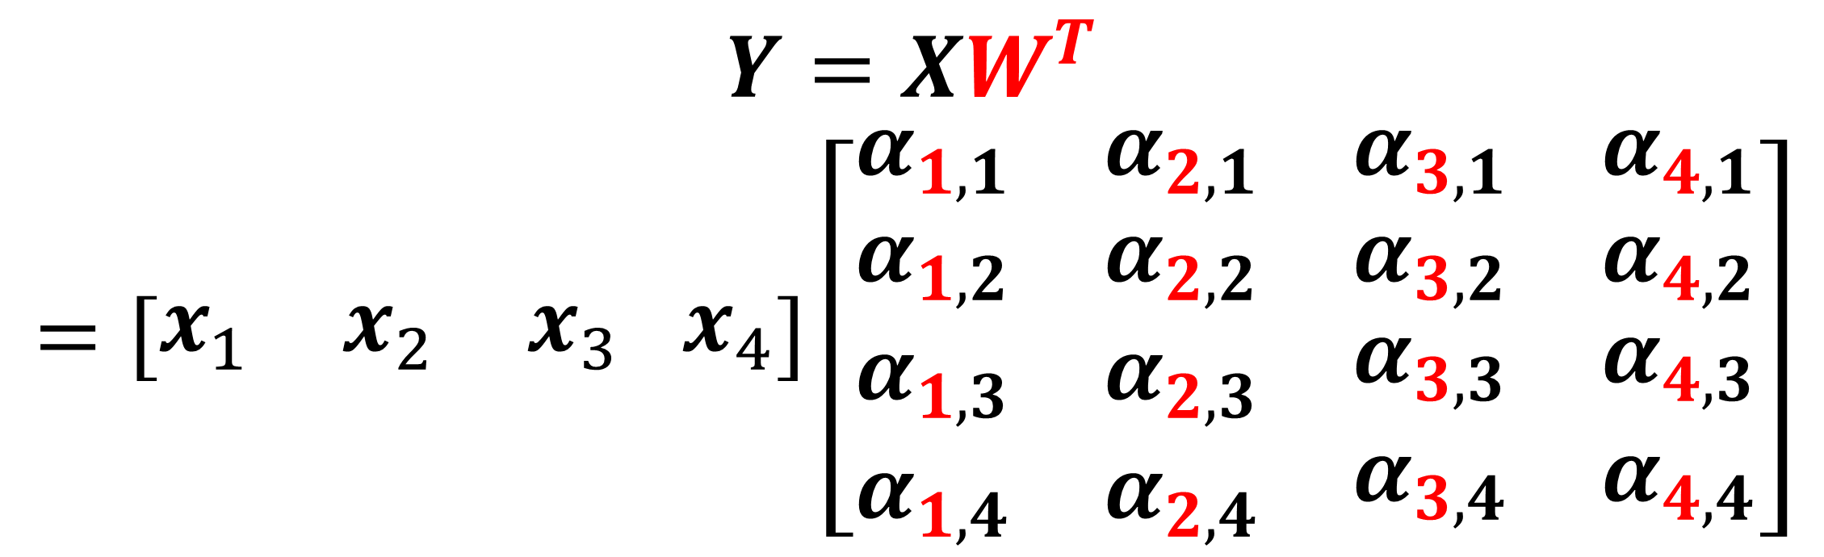
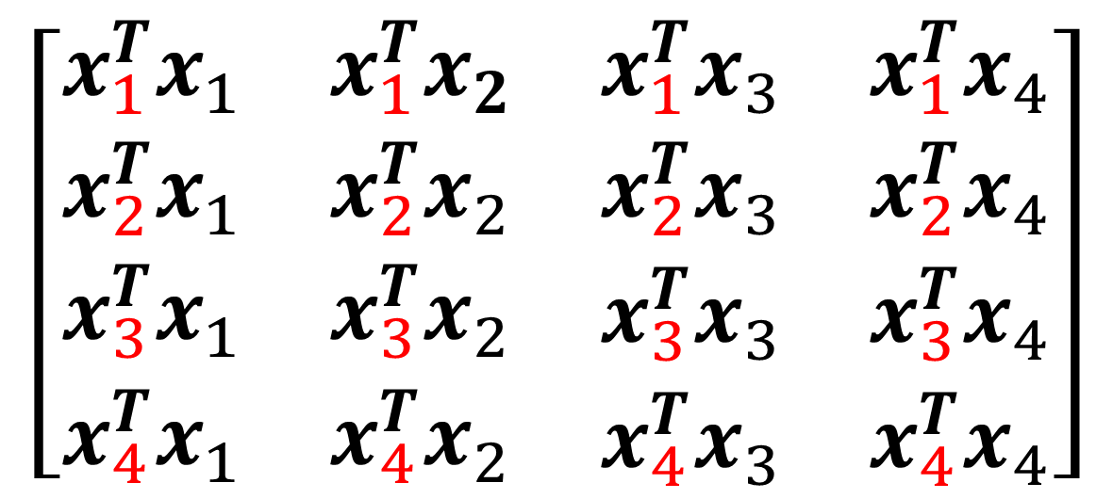
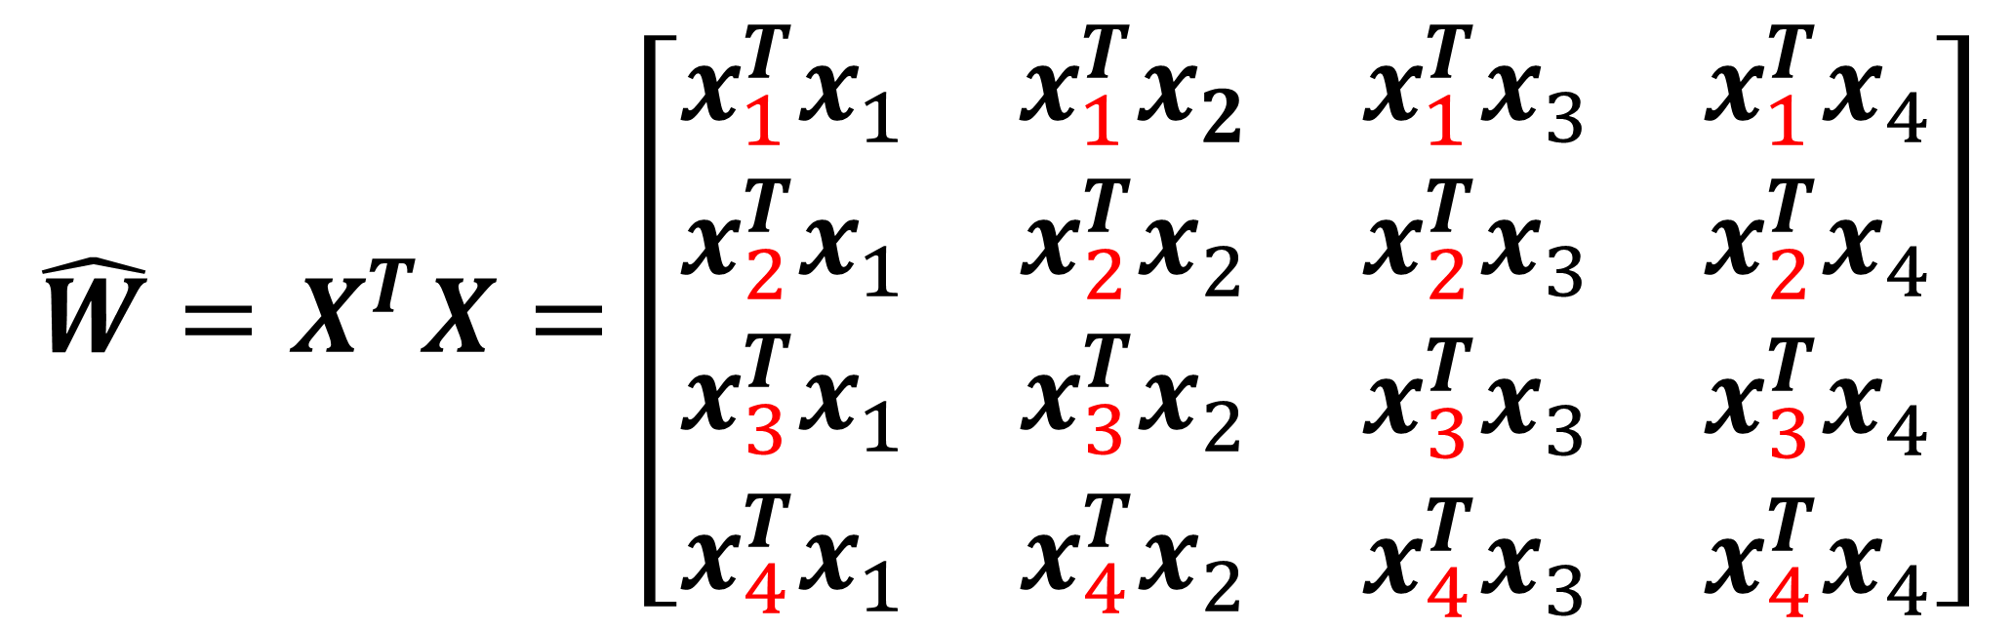
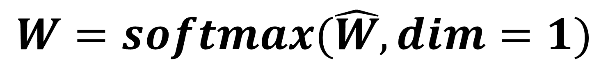
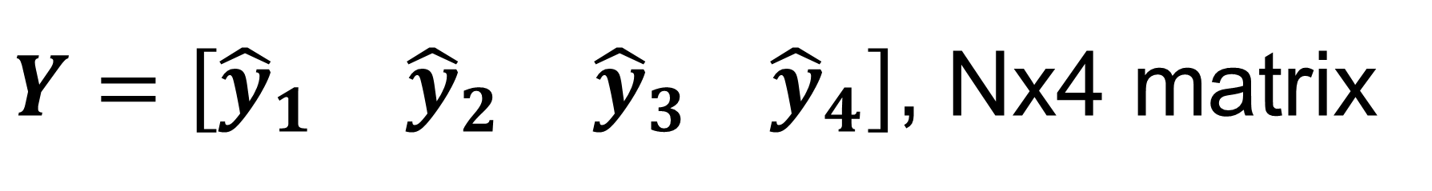
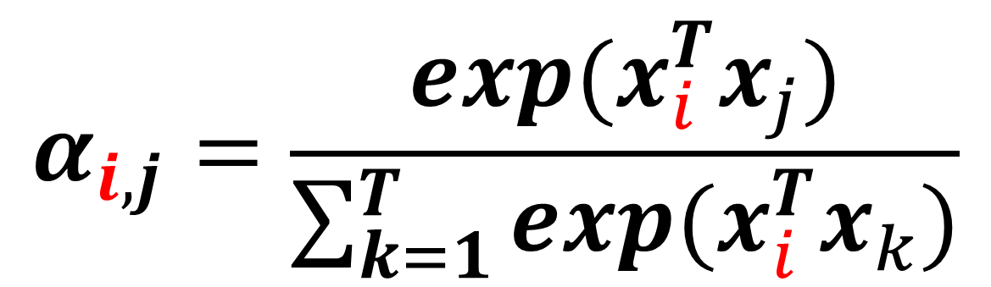
Self-attention
$$\hat{W}=X^{T}X=\left[\begin{matrix}\begin{aligned}x_{1}^{T}x_{1} \\ x_{2}^{T}x_{1}\end{aligned} & \begin{aligned}x_{1}^{T}x_{2} \\ x_{2}^{T}x_{2}\end{aligned} & \begin{aligned}\begin{matrix}x_{1}^{T}x_{3} & x_{1}^{T}x_{4}\end{matrix} \\ \begin{matrix}x_{2}^{T}x_{3} & x_{2}^{T}x_{4}\end{matrix}\end{aligned} \\ x_{3}^{T}x_{1} & x_{3}^{T}x_{2} & \begin{matrix}x_{3}^{T}x_{3} & x_{3}^{T}x_{4}\end{matrix} \\ x_{4}^{T}x_{1} & x_{4}^{T}x_{2} & \begin{matrix}x_{4}^{T}x_{3} & x_{4}^{T}x_{4}\end{matrix}\end{matrix}\right]$$
$$\left[\begin{matrix}\begin{aligned}x_{1}^{T}x_{1} \\ x_{2}^{T}x_{1}\end{aligned} & \begin{aligned}x_{1}^{T}x_{2} \\ x_{2}^{T}x_{2}\end{aligned} & \begin{aligned}\begin{matrix}x_{1}^{T}x_{3} & x_{1}^{T}x_{4}\end{matrix} \\ \begin{matrix}x_{2}^{T}x_{3} & x_{2}^{T}x_{4}\end{matrix}\end{aligned} \\ x_{3}^{T}x_{1} & x_{3}^{T}x_{2} & \begin{matrix}x_{3}^{T}x_{3} & x_{3}^{T}x_{4}\end{matrix} \\ x_{4}^{T}x_{1} & x_{4}^{T}x_{2} & \begin{matrix}x_{4}^{T}x_{3} & x_{4}^{T}x_{4}\end{matrix}\end{matrix}\right]$$
Softmax along row
$$W=softmax(\hat{W}, dim=1)$$
Attention score
$Y=\left[\begin{matrix}{\hat{y}}_{1} & {\hat{y}}_{2} & {\hat{y}}_{3} {\hat{y}}_{4}\end{matrix}\right]$, Nx4 matrix
$$W=\left[\begin{matrix}\begin{aligned}α_{1,1} \\ α_{2,1}\end{aligned} & \begin{aligned}α_{1,2} \\ α_{2,2}\end{aligned} & \begin{aligned}\begin{matrix}α_{1,3} & α_{1,4}\end{matrix} \\ \begin{matrix}α_{2,3} & α_{2,4}\end{matrix}\end{aligned} \\ α_{3,1} & α_{3,2} & \begin{matrix}α_{3,3} & α_{3,4}\end{matrix} \\ α_{4,1} & α_{4,2} & \begin{matrix}α_{4,3} & α_{4,4}\end{matrix}\end{matrix}\right]$$
$$Y=XW^{T}$$
$$=\left[\begin{matrix}x_{1} & x_{2} & x_{3} x_{4}\end{matrix}\right]\left[\begin{matrix}\begin{aligned}α_{1,1} \\ α_{1,2}\end{aligned} & \begin{aligned}α_{2,1} \\ α_{2,2}\end{aligned} & \begin{aligned}\begin{matrix}α_{3,1} & α_{4,1}\end{matrix} \\ \begin{matrix}α_{3,2} & α_{4,2}\end{matrix}\end{aligned} \\ α_{1,3} & α_{2,3} & \begin{matrix}α_{3,3} & α_{4,3}\end{matrix} \\ α_{1,4} & α_{2,4} & \begin{matrix}α_{3,4} & α_{4,4}\end{matrix}\end{matrix}\right]$$
$$α_{i,j}=\frac{exp(x_{i}^{T}x_{j})}{\sum_{k=1}^{T}{exp(x_{i}^{T}x_{k})}}$$
$${\hat{y}}_{1}=α_{1,1}x_{1}+α_{1,2}x_{2}+α_{1,3}x_{3}+α_{1,4}x_{4}$$

Slide 11
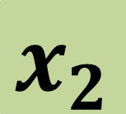

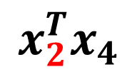

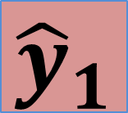




















Self-attention
$x_{i}$: Nx1 vector
$X=\left[\begin{matrix}x_{1} & x_{2} & x_{3} x_{4}\end{matrix}\right]$, NxT matrix
$\hat{W}=X^{T}X$, TxT matrix
$W=softmax\left(\hat{W}, dim=1\right)=[α_{i,j}]$, TxT matrix
$Y=\left[\begin{matrix}{\hat{y}}_{1} & {\hat{y}}_{2} & {\hat{y}}_{3} {\hat{y}}_{4}\end{matrix}\right]=XW^{T}$, NxT matrix
We want to compute output at this position
$${\hat{y}}_{1}$$
$${\hat{y}}_{2}$$
$${\hat{y}}_{3}$$
$${\hat{y}}_{4}$$
+
$$x_{2}$$
×
$$x_{2}$$
×
$$x_{2}$$
×
$$x_{2}$$
×
$$α_{2,1}$$
$$α_{2,2}$$
$$α_{2,3}$$
$$α_{2,4}$$
softmax
$${\hat{y}}_{i}=\sum_{j=1}^{T}{α_{i,j}x_{j}}$$
$$x_{2}^{T}x_{1}$$
$$x_{2}^{T}x_{2}$$
$$x_{2}^{T}x_{3}$$
$$x_{2}^{T}x_{4}$$
Output is a weighted average of inputs
Weights measure how “close” two input vectors are
Given output position $i$, a $x_{j}$ that is “closer” to input $x_{i}$ has higher weight
$$x_{1}$$
$$x_{2}$$
$$x_{3}$$
$$x_{4}$$

Slide 12




























Attention
Self-attention
√ parallel computing
√ process sequence data
Has no learnable parameters
So let’s introduce learnable parameters
We want to compute output at this position
$${\hat{y}}_{1}$$
$${\hat{y}}_{2}$$
$${\hat{y}}_{3}$$
$${\hat{y}}_{4}$$
+
$$v_{1}$$
×
$$v_{2}$$
×
$$v_{3}$$
×
$$v_{4}$$
×
$$α_{2,1}$$
$$α_{2,2}$$
$$α_{2,3}$$
$$α_{2,4}$$
softmax
$${q_{i}=W_{q}x}_{i}$$
query
Bias term can be added too
$$q_{2}^{T}k_{1}$$
$$q_{2}^{T}k_{2}$$
$$q_{2}^{T}k_{3}$$
$$q_{2}^{T}k_{4}$$
$${k_{i}=W_{k}x}_{i}$$
key
$$q_{2}$$
$$q_{2}$$
$$k_{3}$$
$$q_{2}$$
$${v_{i}=W_{v}x}_{i}$$
value
$$v_{i}$$
$$k_{1}$$
$$q_{2}$$
$$k_{2}$$
$$k_{4}$$
$W_{q}$ and $W_{k}$ : DxN matrix
$W_{v}$ : VxN matrix
Q and K : DxT matrix
V: VxT matrix
D is the working dimension of attention
$${ W}_{v}$$
$${ W}_{k}$$
$${ W}_{q}$$
$${ W}_{k}$$
$${ W}_{k}$$
$${ W}_{k}$$
$$x_{i}$$
$$x_{1}$$
$$x_{2}$$
$$x_{3}$$
$$x_{4}$$

Slide 13







Attention
$x_{i}$: Nx1 vector
$X=\left[\begin{matrix}x_{1} & x_{2} & x_{3} x_{4}\end{matrix}\right]$, NxT matrix
$W_{q}$ and $W_{k}$: DxN matrix; $W_{v}$: VxN matrix
$Q=W_{q}X$, DxT matrix
$K=W_{k}X$, DxT matrix
$V=W_{v}X$, VxT matrix
$\hat{W}=Q^{T}K$, TxT matrix
$W=softmax\left(\hat{W}, dim=1\right)=[α_{i,j}]$, TxT matrix
$Y=VW^{T}$, VxT matrix
We want to compute output at this position
$${\hat{y}}_{1}$$
$${\hat{y}}_{2}$$
$${\hat{y}}_{3}$$
$${\hat{y}}_{4}$$
+
$$v_{1}$$
×
$$v_{2}$$
×
$$v_{3}$$
×
$$v_{4}$$
×
Learnable parameters:
$W_{q}$, $W_{k}$, $W_{v}$
Do not depend on T
$$α_{2,1}$$
$$α_{2,2}$$
$$α_{2,3}$$
$$α_{2,4}$$
softmax
$$q_{2}^{T}k_{1}$$
$$q_{2}^{T}k_{2}$$
$$q_{2}^{T}k_{3}$$
$$q_{2}^{T}k_{4}$$
$$k_{1}$$
$$q_{2}$$
$$k_{2}$$
$$k_{3}$$
$$k_{4}$$
$$x_{2}$$

Slide 14




Scaled Attention
$$α_{i,j}=\frac{q_{i}^{T}k_{j}}{\sqrt{D}}$$
$$α_{i,j}=q_{i}^{T}k_{j}$$
$\hat{W}=\frac{Q^{T}K}{\sqrt{D}}$, TxT matrix
Dot product increases with higher dimension
A unit vector of dimension D has length $\sqrt{D}$

Slide 15


















Multi-head Attention
$${\hat{y}}_{1}^{1}$$
$${\hat{y}}_{2}^{1}$$
$${\hat{y}}_{3}^{1}$$
$${\hat{y}}_{4}^{1}$$
$${\hat{y}}_{1}^{2}$$
$${\hat{y}}_{2}^{2}$$
$${\hat{y}}_{3}^{2}$$
$${\hat{y}}_{4}^{2}$$
$W_{q}^{1}$,$W_{k}^{1}$,$W_{v}^{1}$
$W_{q}^{2}$,$W_{k}^{2}$,$W_{v}^{2}$
$$x_{1}$$
$$x_{2}$$
$$x_{3}$$
$$x_{4}$$
Increase representation power to capture multiple possible relevance across long time points
$$x_{1}$$
$$x_{2}$$
$$x_{3}$$
$$x_{4}$$

Slide 16


















Multi-head Attention
$${\hat{y}}_{1}^{1}$$
$${\hat{y}}_{2}^{1}$$
$${\hat{y}}_{3}^{1}$$
$${\hat{y}}_{4}^{1}$$
$${\hat{y}}_{1}^{2}$$
$${\hat{y}}_{2}^{2}$$
$${\hat{y}}_{3}^{2}$$
$${\hat{y}}_{4}^{2}$$
$W_{q}^{1}$,$W_{k}^{1}$,$W_{v}^{1}$
$W_{q}^{2}$,$W_{k}^{2}$,$W_{v}^{2}$
$$x_{1}$$
$$x_{2}$$
$$x_{3}$$
$$x_{4}$$
$${\hat{y}}_{1}=W_{o}\left[\begin{matrix}{\hat{y}}_{1}^{1} \\ {\hat{y}}_{1}^{2}\end{matrix}\right]$$
$W_{o}$: Vx2V matrix, learnable parameter
Also possible to split input vector into chunks, e.g. if H=2 for two heads,
$$x_{1}$$
$x_{1}^{1}=$ $x_{1}[0:N/2]$, $x_{1}^{2}=$ $x_{1}[N/2:N]$
Nx1

Slide 17

Attention is a set-to-set operation
$${\hat{y}}_{1}$$
$${\hat{y}}_{2}$$
$${\hat{y}}_{3}$$
$${\hat{y}}_{4}$$
Computational operations for $x_{i}$ and $x_{j}$ are 100% identical
If we switch position of $x_{i}$ and $x_{j}$, outputs stay the same, but only with switched position
if $x_{i}⟺x_{j}$, then ${\hat{y}}_{i}⟺{\hat{y}}_{j}$
$$x_{1}$$
$$x_{2}$$
$$x_{3}$$
$$x_{4}$$

Slide 18





Attention is a set-to-set operation
$${\hat{y}}_{1}$$
$${\hat{y}}_{3}$$
$${\hat{y}}_{2}$$
$${\hat{y}}_{4}$$
Computational operations for $x_{i}$ and $x_{j}$ are 100% identical
If we switch position of $x_{i}$ and $x_{j}$, outputs stay the same, but only with switched position
if $x_{i}⟺x_{j}$, then ${\hat{y}}_{i}⟺{\hat{y}}_{j}$
Attention(Permute(X))=Permute(Attention(X))
Non-causal
$$x_{1}$$
$$x_{3}$$
$$x_{2}$$
$$x_{4}$$

Slide 19








Add position information: Position encoding
Position encoding
A designed function to map position to a N dimensional vector
$$p=f(loc)$$
Add position vector to input
$${\hat{y}}_{1}$$
$${\hat{y}}_{2}$$
$${\hat{y}}_{3}$$
$${\hat{y}}_{4}$$
Handcrafted, but can work well
$p$ vector
$$x_{1}+p_{1}$$
$$x_{2}+p_{2}$$
$$x_{3}+p_{3}$$
$$x_{4}+p_{4}$$
Attention Is All You Need. https://arxiv.org/abs/1706.03762

Slide 20


Add position information: Position embedding
Position embedding
$$p=f(loc)$$
Learn the mapping function f
Add position vector to input
Limited by the sequence length, less flexible
$${\hat{y}}_{1}$$
$${\hat{y}}_{2}$$
$${\hat{y}}_{3}$$
$${\hat{y}}_{4}$$
$$x_{1}+p_{1}$$
$$x_{2}+p_{2}$$
$$x_{3}+p_{3}$$
$$x_{4}+p_{4}$$
Learning to Encode Position for Transformer with Continuous Dynamical Model. https://arxiv.org/abs/2003.09229
https://towardsdatascience.com/master-positional-encoding-part-i-63c05d90a0c3

Slide 21








Use attention layer
$${\hat{y}}_{1}$$
$${\hat{y}}_{2}$$
$${\hat{y}}_{3}$$
$${\hat{y}}_{4}$$
As flexible as RNN
Non-causal by default
Parallel computing
Replacing RNN in many sequence models
Attention+non-linearity+FC or CONV -> a transformer module
$$x_{1}$$
$$x_{2}$$
$$x_{3}$$
$$x_{4}$$

Slide 22








Use attention layer
Global pooling
$${\hat{y}}_{1}$$
$${\hat{y}}_{2}$$
$${\hat{y}}_{3}$$
$${\hat{y}}_{4}$$
Sentimental analysis
I bought this TV last week. It arrived today. This TV is broken …
Positive review or negative review?
$$This$$
$$TV$$
$$is$$
$$broken$$

Slide 23





Use attention layer
Probability of being triggered at the 2nd time interval
$${\hat{y}}_{1}$$
$${\hat{y}}_{2}$$
$${\hat{y}}_{3}$$
$${\hat{y}}_{4}$$
ECG Waveform detection
$x_{1},$ $x_{2}$, $x_{3}$, $x_{4}$, …
$x_{1}$ $x_{2}$ $x_{3}$ $x_{4}$

Slide 24

Use attention layer
$${\hat{y}}_{i}=play,$$
Probability of “play” from vocabulary
Predict masked words
Only compute loss on the masked words
Parallel computing speeds up the training
……
……
……
Tom went out to [play] the tennis
Tom went out to <MSK> the tennis

Slide 25
Use attention layer: Masked attention
Masked attention
Default attention is non-causal
Masked out the attention score matrix to make it causal
went out to play
$$Y=XW^{T}$$
$${\hat{y}}_{1}=α_{1,1}x_{1}+α_{1,2}x_{2}+α_{1,3}x_{3}+α_{1,4}x_{4}$$
$${\hat{y}}_{2}=α_{2,1}x_{1}+α_{2,2}x_{2}+α_{2,3}x_{3}+α_{2,4}x_{4}$$
$${\hat{y}}_{3}=α_{2,1}x_{1}+α_{2,2}x_{2}+α_{2,3}x_{3}+α_{2,4}x_{4}$$
$${\hat{y}}_{4}=α_{2,1}x_{1}+α_{2,2}x_{2}+α_{2,3}x_{3}+α_{2,4}x_{4}$$
Tom went out to

Slide 26


Use attention layer: Masked attention
Masked attention
Masked out the upper triangle of W matrix
Causal attention
went out to play
$$W=\left[\begin{matrix}\begin{aligned}α_{1,1} \\ α_{2,1}\end{aligned} & \begin{aligned}α_{1,2} \\ α_{2,2}\end{aligned} & \begin{aligned}\begin{matrix}α_{1,3} & α_{1,4}\end{matrix} \\ \begin{matrix}α_{2,3} & α_{2,4}\end{matrix}\end{aligned} \\ α_{3,1} & α_{3,2} & \begin{matrix}α_{3,3} & α_{3,4}\end{matrix} \\ α_{4,1} & α_{4,2} & \begin{matrix}α_{4,3} & α_{4,4}\end{matrix}\end{matrix}\right]$$
$$W_{masked}=\left[\begin{matrix}\begin{aligned}α_{1,1} \\ α_{2,1}\end{aligned} & \begin{aligned}0 \\ α_{2,2}\end{aligned} & \begin{aligned}\begin{matrix} 0 & 0\end{matrix} \\ \begin{matrix} 0 & 0\end{matrix}\end{aligned} \\ α_{3,1} & α_{3,2} & \begin{matrix}{ α}_{3,3} & 0\end{matrix} \\ α_{4,1} & α_{4,2} & \begin{matrix}{ α}_{4,3} & 0\end{matrix}\end{matrix}\right]$$
Tom went out to

Slide 27

Transformer: A Seq2Seq model
深度学习速成课
Sole relying on the attention mechanism to model long-term dependency in a sequence
Propose the “transformer” module
Scaled attention, masked attention, multi-head attention, position encoding …
Encoder
Decoder
Cross attention
deep learning crash course
Encoder
Decoder
Input and output are sequences, with variable length
Examples: machine translation, speech recognition, image captioning …
Three components: encoder, decoder, their cross-talk
Attention Is All You Need. https://arxiv.org/abs/1706.03762

Slide 28








Transformer: Encoder
$y_{1}$, Nx1
$Y$, NxT matrix
Layer
normalization
Layer normalization
$$μ_{1}=\frac{1}{N}\sum_{k=1}^{N}{b_{1}(k)}$$
$$σ_{1}=\frac{1}{N}\sum_{k=1}^{N}{{[b_{1}\left(k\right)−μ_{1}]}^{2}}$$
$${\tilde{c}}_{1}=\frac{b_{1}−μ_{1}}{\sqrt{σ_{1}}+ε}$$
$${c_{1}=γ_{1}\tilde{c}}_{1}+β_{1}$$
FC+ReLU
$$c_{1}$$
Layer normalization along N
Attention layer is the only place to model dependency across sequence
LayerNorm and FC are applied for each vector independently
Layer
normalization
$X$ , NxT matrix
$$b_{1}$$
N is the dimensional of input sequence data
(output of word embedding layer)
T is the length of sequence
Skip connection
$a_{1}$, Nx1
Multi-head attention
Attention Is All You Need. https://arxiv.org/abs/1706.03762
$x_{1}$, Nx1,
one vector in the sequence

Slide 29

Transformer: Encoder
Recent implementation often used option (b)
Shown to improve training stability and speed
Intuitively, all inputs into attention layers have been normalized
On Layer Normalization in the Transformer Architecture. https://arxiv.org/abs/2002.04745

Slide 30
Transformer: Decoder
Same as the encoder
Same as the encoder, except using the masked attention layer
Attention Is All You Need. https://arxiv.org/abs/1706.03762

Slide 31
Transformer: Cross attention
Key and value is from encoder
Query is from decoder
Auto-regressive training
deep learning crash course
深度学习速成课
深
度
学
习
速
成
课
<end>
K
Q
V
Vocabulary size vector
Encoder
Decoder
<start>
深
度
学
习
速
成
课
deep learning crash course
Process in parallel
Teacher forcing
Attention Is All You Need. https://arxiv.org/abs/1706.03762

Slide 32





















Transformer: Cross attention
深
… …
Use encoder as the “dictionary” to store the information about input sequence
Decoder wants to know what is in the input sequence. So, do query on the “dictionary"
+
×
$$α_{1,1}$$
×
$$α_{1,2}$$
×
$$α_{1,3}$$
×
$$α_{1,4}$$
$${ W}_{v}$$
$${ W}_{k}$$
$${ W}_{q}$$
$$q_{1}$$
K
V
Q
$${ W}_{v}$$
$${ W}_{k}$$
$${ W}_{v}$$
$${ W}_{k}$$
$${ W}_{v}$$
$${ W}_{k}$$
$${ W}_{v}$$
$${ W}_{k}$$
$$y_{1}$$
$$y_{2}$$
$$y_{3}$$
$$y_{4}$$
$${ W}_{q}$$
Encoder
Masked attention, Layer Norm, Add
deep learning crash course
<start>
Attention Is All You Need. https://arxiv.org/abs/1706.03762

Slide 33






Transformer: Cross attention
度
… …
Until we get <end>
+
×
$$α_{2,1}$$
×
$$α_{2,2}$$
×
$$α_{2,3}$$
×
$$α_{2,4}$$
$${ W}_{v}$$
$${ W}_{k}$$
$${ W}_{q}$$
$$q_{2}$$
K
V
Q
$${ W}_{v}$$
$${ W}_{k}$$
$${ W}_{v}$$
$${ W}_{k}$$
$${ W}_{v}$$
$${ W}_{k}$$
$${ W}_{v}$$
$${ W}_{k}$$
$${ W}_{q}$$
$$y_{1}$$
$$y_{2}$$
$$y_{3}$$
$$y_{4}$$
Encoder
Masked attention, Layer Norm, Add
deep learning crash course
<start>
深
Attention Is All You Need. https://arxiv.org/abs/1706.03762

Slide 34
Transformer: Multiple transformer layers
Encoder
深
度
学
习
速
成
课
<end>
Take the output of encoder and feed it to all decoders to compute key and value
Encoder
Decoder
Encoder
Decoder
Encoder
Decoder
deep learning crash course
<start>
深
度
学
习
速
成
课
Attention Is All You Need. https://arxiv.org/abs/1706.03762

Slide 35

Transformer: different cross attention is possible
Layer-Wise Multi-View Decoding for Natural Language Generation. https://arxiv.org/abs/2005.08081

Slide 36



NLP models based on transformer
1 year later, trillion parameters
WuDao 2.0
June 2021
1.75 Trillion
https://www.stateof.ai/
1.6 Trillion
ELMO: 97M
Bert: 340M
Pre-train the transformer backbone on large corpse of texts
Use self-supervised learning
Fine-tuning for new tasks
https://github.com/huggingface/transformers

Slide 37




Elmo: Embeddings from language model
deep learning crash course <end>
Only the first layer sees the embedding
Embedding is from either pre-training or a simple linear transformation
Contextual embedding
ELMO: produce embedding from more complicated model and combine contribution of different layers in embedding generation
Bi-directional LSTM is pre-trained
Downstream layer and $α, β,γ$ are learnable
deep learning crash course <end>
Downstream layers
Transformer
$$ELMO embedding = α× + β× + γ×$$
Transformer
Transformer
World embedding
<start> deep learning crash course
NLP's ImageNet moment has arrived. https://ruder.io/nlp-imagenet/

Slide 38


Elmo: Embeddings from language model
ImageNet moment for NLP
Pre-train on large corpus and fine tuning for downstream tasks
This idea is further utilized by Bert, GPT and many more to follow …
Deep contextualized word representations. https://arxiv.org/abs/1802.05365
https://allennlp.org/elmo

Slide 39

BERT: Bidirectional Encoder Representations from Transformers
Outputs, VxT matrix
… …
Wordpiece token
walking → tokened at “walk” and “ing”, ~30K vocabulary
Pre-trained on large dataset
2.5B words from Wiki, 800M words from BooksCorpus
Non-causal training → give a sentence, output a sequence of probabilities
Pre-trained + fine tuning
24 transformer block, D=1024, 16 heads, 4 FC + relu, hidden size 4096,
340M parameters

Slide 40
BERT: Bidirectional Encoder Representations from Transformers
Two Pre-training tasks, trained jointly
Word masking
Next sentence prediction
Compute loss for this word
Yes or no
deep learning crash course
Bert
Bert
deep learning <mask> course
<CLS> weather is good <SEP> let us go to park

Slide 41

Use BERT as a feature extractor for NLP
Similar to ImageNet based models for transfer learning, with specific adaption to NLP tasks
Summarization
Sentimental analysis
Can be fine-tuned for many other NLP tasks
Need some insights to design the training procedure for new task
Bert worked as a good feature extractor to capture contextual and long-range dependence
Trained for more than 100 languages
Positive or negative
Binary classifier
Learnable
Bert
Fine tuning
<CLS> this movie is boring and pointless
https://github.com/huggingface/transformers

Slide 42
GPT, GPT2, GPT3: Generative Pre-Training
deep
learning
crash
course
<end>
GPT: 12 decoder modules, 117M parameters
Decoder
GPT 2: 48 decoder modules, 1.5B parameters
Model dimension 768, 12 heads, FC dim 3072
Trained on 8M documents, ~40GB, trained on long sequence of 1024 tokens
Decoder
… …
GPT 3: 96 decoder modules, 175B parameters
Decoder
Model dimension 12288, 96 heads, FC dim 4x12288, trained on sequence 2048 token
~10K GPUs, two weeks, ~$4.6M to train in 2020, ~1000B words from high-quality texts
Decoder
(masked attention + LayNorm+FC)
<start>
deep
learning
crash
course
Generating wikipedia by summarizing long sequences. https://arxiv.org/pdf/1801.10198.pdf

Slide 43

GPT is to predict a sequence
Give a prompt
Input prompt to model and generate q/k/v
Sample a new word
Auto-regressive generation
The attention mechanism works as a “soft dictionary” to allow a prompt to query the model
https://jalammar.github.io/how-gpt3-works-visualizations-animations/

Slide 44

play with GPT2
https://transformer.huggingface.co/doc/gpt2-large
https://talktotransformer.com

Slide 45



GPT3 is not released to public
Open for licensing for commercial applications
https://github.com/EleutherAI/gpt-neo

Slide 46



GPT3 is a few-shot learner
Since the model learned a lot of knowledge, a few prompts are often enough to provide good query for a specific task
Language models are few-shot learners . https://arxiv.org/abs/2005.14165

Slide 47


GPT3 has its biases
Prompt model with “The {race} man was very”, The {race} woman was very” …
Generate 800 samples
Check words co-occurrences with {race} in the samples
Measure sentiment as a score, e.g. wonderfulness: 100, wretched: -87.5
Language models are few-shot learners . https://arxiv.org/abs/2005.14165

Slide 48

Transformer to generate images
12-billion parameter version of GPT-3 trained to generate images from text descriptions, using a dataset of text–image pairs
Both texts and images are tokenized
Train a discrete variational autoencoder to compress each 256×256 RGB image into a 32 × 32 grid of image tokens, each element of which can assume 8192 possible values.
Input a sentence or image prompt, model outputs tokens for images. These tokens are then decompressed to become images
Text-to-image synthesis
Named after
the artist Salvador Dalí and Pixar’s WALL·E.
Zero-Shot Text-to-Image Generation. https://arxiv.org/abs/2102.12092

Slide 49



Transformer to generate images

Slide 50


Transformer for images
An Image is Worth 16x16 Words: Transformers for Image Recognition at Scale. https://arxiv.org/abs/2010.11929

Slide 51


Transformer for object detection
End-to-End Object Detection with Transformers. https://arxiv.org/abs/2005.12872

Slide 52
Transformer is taking over
RNN
Can process variable length long sequences
Sequential computation; not efficient for very long sequences
Assume the order within the sequence
Transformer
Set model in its nature; easy to modify for causal case
Very efficient parallel computing; good at long sequence modeling
Do not assume the order within sequences
Memory intensive
Recent work focuses more on applying attention and transformer to image and video
Key is the attention mechanism and those a few matrix multiplication …

Slide 53

Transformer models: #para
WuDao 2.0
June 2021
1.6 Trillion
The biggest lesson that can be read from 70 years of AI research is that general methods that leverage computation are ultimately the most effective, and by a large margin.
- The Bitter Lesson of AI. Rich Sutton. http://www.incompleteideas.net/IncIdeas/BitterLesson.html
Model capacity is limited by “how big” they are and “how much” training data is
Impressive results already and growing
A path towards more general-purpose AI?

Slide 54

Transformer models: multi-tasking and multi-modality
WuDao 2.0, 1.75 Trillion parameters
Trained on 4.9TB of cleaned text and image data
GPT3 trained on 570GB texts
Multi-modality: work on both images and texts
Use Mixture-of-Experts: FastMoE
https://github.com/laekov/fastmoe
Multi-tasks: NLP, text generation, image recognition, image generation, image captioning, artwork generation given the text …
In the neural network community, several researchers have examined the decomposition methodology. […] Mixture–of–Experts (ME) methodology that decomposes the input space, such that each expert examines a different part of the space. […] A gating network is responsible for combining the various experts.
— Page 73, Pattern Classification Using Ensemble Methods, 2010.

